Slide 1
SAG-DRONING
Shubham,Arman,Gursehaj

Slide 2

Something about drones

Slide 3

They are expensive to own

Slide 4


Slide 5


Slide 6
How about a cheaper solution
An application that will
Show in app data of your drone
Temperature warnings
Atmospheric pressure detection
Axial location of the drone
Drone crash warning
GPS location(beta)
Secure login for the data
Live data.

Slide 7
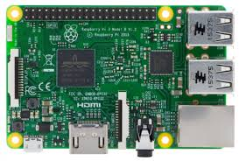
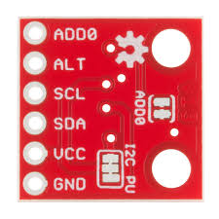
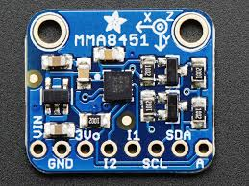
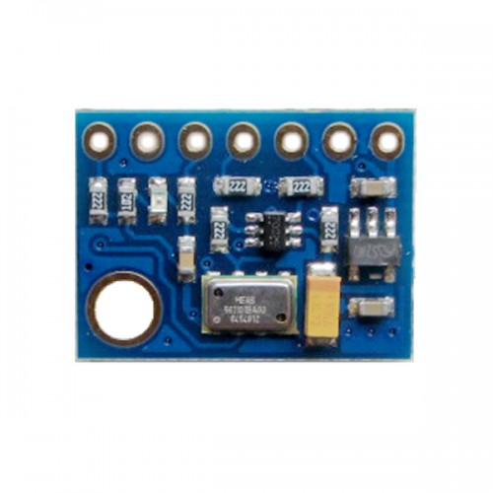
HARDWARE COMPONETS

Slide 8
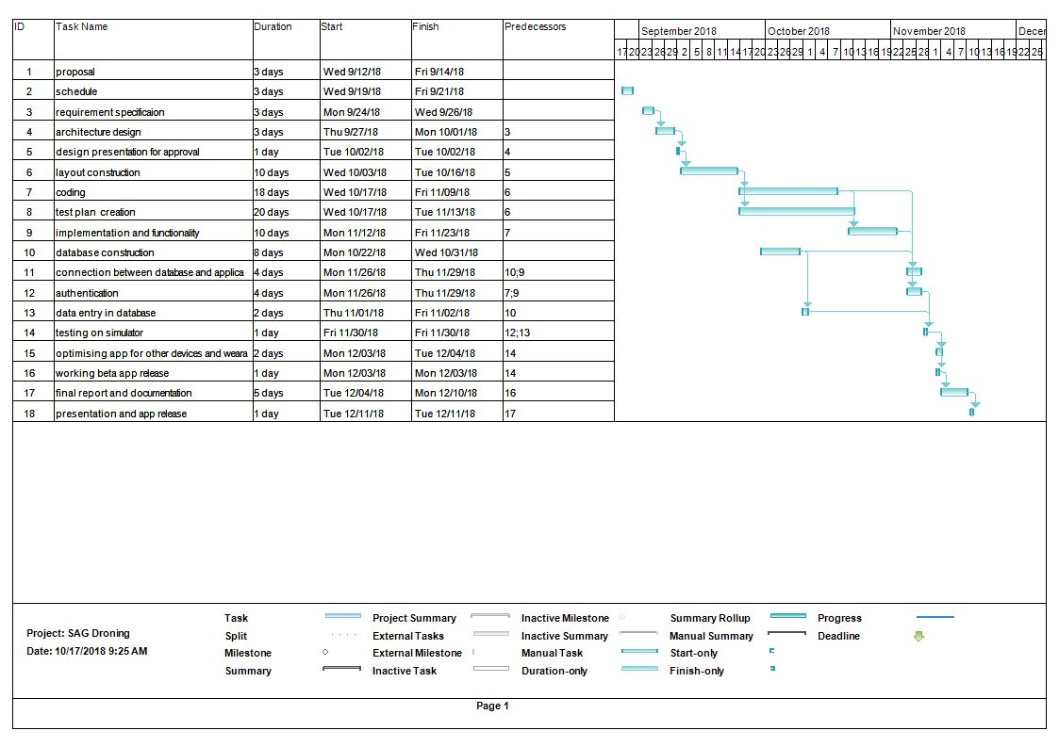
Gnatt chart

Slide 9
LETS HAVE A LOOK AT OUR APP
SAG DRONING TEAM

